Slide 1

The natural law
ITS ESSENCE
“LEX”. -- “The rule and measure of acts, whereby man is induced to act or is restrained from action. . .”
”LIGARE”. -- Latin meaning to bind.
REASON – The rule and measure of human acts is reason, as our human intellect is guided by reason, it belongs to us to direct our actions and ultimately our end, which per the promise of Christ, is Heaven.

Slide 2
The natural law
ITS ESSENCE
The LAW is ordered to the common good, not to the individual.
Lawmaking belongs to the PEOPLE as a whole or to an institution (divine right v. The people). The power to make law in the U.S.A. is constituted in the Congress of the United States and the several state legislatures.
Law must have binding force, therefore knowledge of the law is necessary; it must be published or “promulgated.”

Slide 3
I. Kinds of “lex”
I. ETERNAL LAW
II. NATURAL LAW
III. HUMAN LAW
IV. DIVINE LAW
V. LAW OF THE “FOMES.”
VI. INCLINATION TO SIN

Slide 4
ETERNAL LAW
  The whole world, indeed, the entire universe, is ruled by Divine Providence and Divine Reason. The eternal law is unchangeable truth. God is not subject to time; this kind is called the Eternal Law. Humanity may know the law but only imperfectly. As rationale creatures, humans can learn and know the truth of God but imperfectly. All laws be they moral, physical, or human, proceed from the eternal law.

Slide 5
Natural law
& physics
  The law of physics. The law of nature. One governs Creation, the universe, and irrational animals. The other governs the rational beings, e.g. mankind.

Slide 6
natural LAW
  The natural law proceeds from the eternal law, and is the law written on our hearts and in our minds. St. Paul notes it Romans 2:14-15. All of creation is ruled and measured by the eternal law, and the natural law governs rational creatures, e.g. human beings. The natural law is based on reason and enables each person to discern what is good and what is evil.

Slide 7
natural LAW
  THE TEN COMMANDMENTS
  The LORD gave Moses the 10 Commandments in the O.T., but promised in Jeremiah, “Behold … I will make a new covenant between the house of Israel … I will put my law within them and I will write it on our hearts. ” The law is written not on stone but on “tables of human hearts.” The power to live righteously.

Slide 8
natural LAW
  In his pure state, mankind’s natural inclination is to act in accordance with reason; and acts of virtue are ordained from the natural law. The natural law is a part of us, yet where the exercise of right reason has been hindered by sin due to concupiscence or other passions, the natural law in the human heart can be blotted out.

Slide 9
human LAW
  Human law is ordained to the common good in the temporal order. St. Thomas noted that human laws have the nature of law, “in so far as it partakes of right reason.” Where it deviates from right reason, it is unjust and is not law but violence.
  Laws are unjust in two ways: (1) contrary to human good, e.g., burdensome, arbitrary, ultra vires, or for the tyrant a source of cupidity or vainglory; and (2) it can be contrary to the Divine good, e.g., laws that induce atheism, idolatry, blasphemy, etc.

Slide 10
human LAW
MLK Jr. noted the force of this argument, when engaging officials on the laws of segregation. Thomas states that any human law that is not rooted in eternal or natural law, is an unjust law.
Even where a law is manifestly unjust, it retains the appearance of law; and it draws on the power of the eternal law. The Book of Romans notes that no authority comes from God and that exist have been instituted by Him.
At the Praetorium in Jerusalem, Our Lord Jesus Christ told Pontius Pilate that he would have no power except what came from above.

Slide 11
human LAW
By its nature, human law has three conditions to fulfill: (1) it must foster religion (virtue); (2) that it is helpful to discipline (obedience); and, (3) it furthers the common weal (common good). In addition to God’s grace, humanity is dependent upon the education and training to be virtuous. Young people are inclined to acts of virtue and truth, either due to a natural disposition, custom, gift of God, or parental training..

Slide 12
human LAW
Yet those who are evil, the law finds it necessary to restrain by the use of force and fear of punishment.
The one distinction between the institution of government and every other local and national private institutions, when implementing the will of the organization, the government alone can use legitimate force to impose its will.
Obey the governing authorities. Romans 13:1-7.

Slide 13
Divine LAW
As mankind suffers from the Fall and its effects, and due to uncertainty of judgment and error, Thomas said that it is necessary for mankind to be directed in his proper and right acts by the Divine law. Man can only judge outward acts, not internal matters, and for the perfection of virtues and to conduct himself rightly, the divine law is the law and instruction of the Church for justification. It directs human beings in the order of righteousness. The Old Law does this by fear; and the new accomplishes this by the love poured into our hearts by the grace of Christ.

Slide 14
Inclination to sin
The Law of the Fomes, as referred to by St. Thomas, is the inherent inclination toward sin and the inordinate sensuality that persists in human beings due to original sin. Before the Fall, in his original natural condition, people were to act in accordance with reason. Yet when he turned his back on God, mankind fell under the influence of his sensual impulses. The more a person diverts from the path of reason, the more one can be likened to a beast.

Slide 15
Effects of law
The law is concerned with human acts, three types (1) acts of virtue, (2) acts of evil, and (3) indifferent acts not good nor evil.
The effect of law is to lead its subjects to their proper virtue, therefore, to be good either simply or in some particular respect. Another effect of law, is that it causes fear of punishment, that ensures compliance.

Slide 16

The natural law
THE NATURAL LAW AND THE EXPERIENCE OF THE UNITED STATES OF AMERICA.
Declaration of Independence of the United States proclaims the existence of God: “Creator,” “Supreme Judge of the World,” ”Nature’s God,” and “Divine Providence.”
Due to the Declaration and U.S. Constitution involves natural law principles, courts can strike down laws that violate these principles.
Laws have adopted precepts from the natural law, e.g. not to kill, right to own property, etc.
Negative law vs. positive law.

Slide 17

The natural law
THE NATURAL LAW AND THE EXPERIENCE OF THE UNITED STATES OF AMERICA.
”A coherent espousal of natural law poses a potentially mortal threat to the prevailing jurisprudence. A coherent natural law approach affirms objective norms, rooted in nature, that are higher even than the Constitution or the Supreme Court. It points to God as the lawgiver, and it threatens to bring up for public discussion the claim of the Catholic Church that the Pope, as Vicar of Christ, is the authoritative interpreter of the natural law.” p. 45, 50 Questions on the Natural Law,” Charles Rice (Ignatius)(1999).

Slide 18
The natural law
CONSTITUTION OF THE UNITED STATES OF AMERICA.
Due Process of law.
Right to life, right to liberty, right to property.
Right to assemble, speech, religious liberty, etc.
Consent of the governed.
Equality before the law

Slide 19
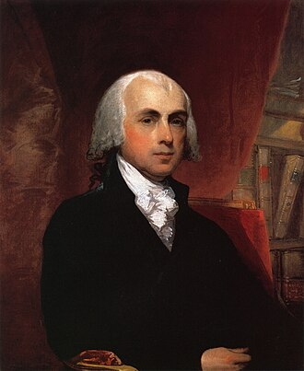
The natural law
FEDERALIST PAPERS
No. 10: “The latent causes of faction are thus sown in the nature of man; and we see them everywhere brought into different degrees of activity, according to the different circumstances of civil society.”
No. 51: “But what is government itself, but the greatest of all reflections on human nature? If men were angels, no government would be necessary. If angels were to govern men, neither external nor internal controls on government would be necessary. In framing a government which is to be administered by men over men, the great difficulty lies in this: you must first enable the government to control the governed; and in the next place oblige it to control itself.”

Slide 20
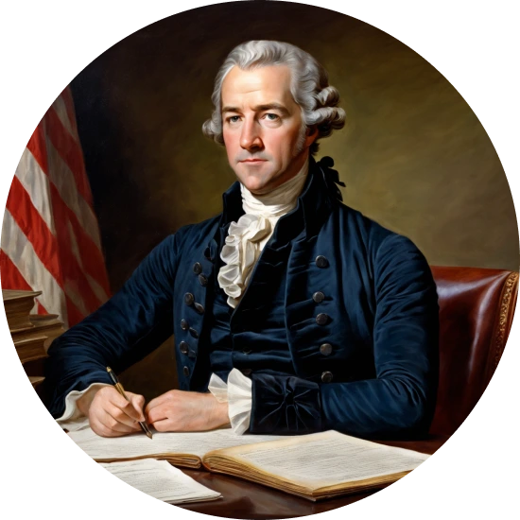
The natural law
FEDERALIST PAPERS
No. 31: “[T]here are certain primary truths, or first principles, upon which all subsequent reasonings must depend. These contain an internal evidence which, antecedent to all reflection or combination, commands the assent of the mind. Where it produces not this effect, it must proceed either from some defect or disorder in the organs of perception, or from the influence of some strong interest, or passion, or prejudice.”

Slide 21
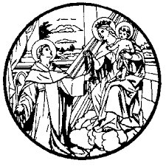

Slide 22
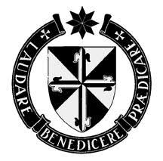
VERITAS
--TRUTH--

Slide 23

THIRD ORDER OF ST. DOMINIC
ST. MARGARET OF CASTELLO CHAPTER
ST. MARK’s CATHOLIC CHURCH, BOISE
Third Saturday of each month, 10:00 o’clock a.m.
www.dominicanidaho.org. www.stdominicsstore.com
Mr. John C. Keenan, OP, JD
208.867.6327
jckeenanop@gmail.com

